Slide 1
Otherness Within Visual Culture
Ethan F. Newman

Slide 2
Key Points
Throughout the history of Western Culture, there has been a prevailing ethnocentrism-that is the belief that one's own country is superior to all others.
This leads to many misconceptions about various cultures of the world that differ from our own.
These misconceptions have led to numerous misrepresentations of many cultures. These misreporting's have been expressed through film, painting, photography, all the way up to contemporary advertising.

Slide 3
Key Points Cont.
As a result, these binary oppositions start to emerge in the world, as well as this notion of the "other"
the representation of different groups within any given society is controlled by groups that have greater political power

Slide 4
The other
People unlike yourself
All non-westernized people of the world
Us Vs. Them
"others' are without power, legitimacy, validity
The knowledge of others is dismissed

Slide 5
Jacques Derrida and Binary Oppositions
According to Derrida, meaning in the West is defined in terms of binary oppositions
Category of the norm= always set up against that which is "deemed abnormal or aberrant in some way" = hence other
“a violent hierarchy” where “one of the two terms governs the other.”
Typically, one of the two opposites assumes a role of dominance over the other= eg. Within the white British/Aboriginal binary opposition in Australia, the indigenous first people of Australia are defined as a devalued 'other.'
Marked/unmarked

Slide 6
Orientalism/paintings
Presenting the East as "the other" or "exotic."
Racialized, feminized, and often sexualized depictions
The idea of some far away exotic land, that frightens us, yet grabs our attention through these false concepts

Slide 7
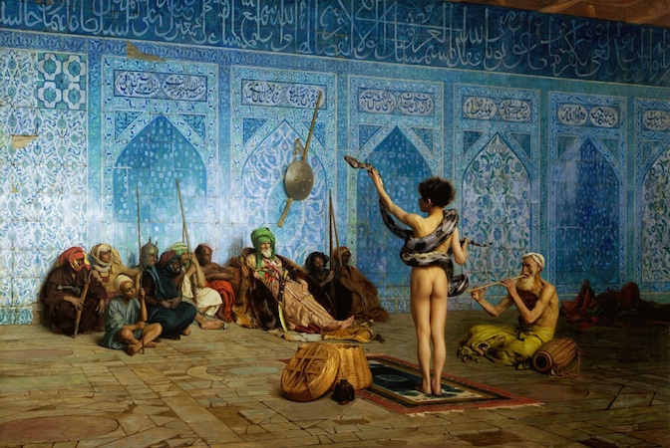
Jean-Leon Gerome- "The Snake Charmer" 1879

Slide 8
Disney's Alladin

Slide 9


Slide 10
"orientalism as a western style for dominating, restructuring, and having authority over the orient."-Edward Said

